Slide 1
Interpreting RUL Predictions Using Temporal SHAP
Nawaf Altahini

Slide 2
What is XAI?
Definition: Methods and techniques that make the decisions and predictions of AI understandable to humans.
Importance:
Builds Trust
Bias Detection
Safety & Reliability
Applications:
Medical Diagnosis
Autonomous Systems
Predictive Maintenance

Slide 3
XAI Methods
LIME
Rule Extraction
Grad-CAM
Approximates a complex model with a simpler, interpretable model
Derives a simple IF-THEN statements that mimics the model’s behavior
Visually highlights important regions in a heatmap using gradients
SHapely Additive exPlanations
Explains predictions by quantifying the contribution of each feature

Slide 4
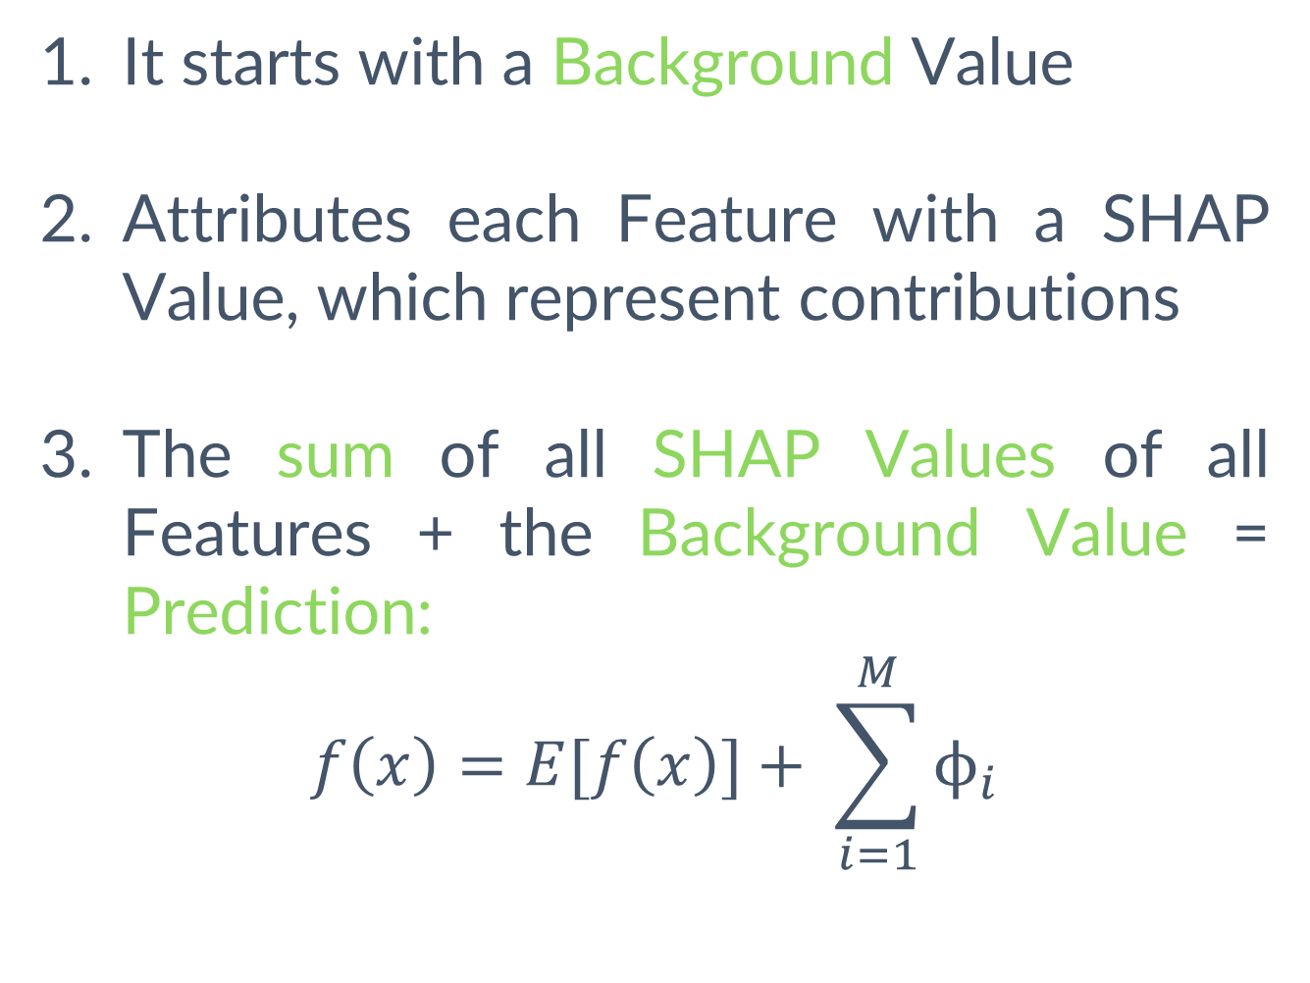
XAI Method: SHAP
SHapely Additive exPlanations
Explains predictions by quantifying the contribution of each feature
It starts with a Background Value
Attributes each Feature with a SHAP Value, which represent contributions
The sum of all SHAP Values of all Features + the Background Value = Prediction:
$$f\left(x\right)=E[f\left(x\right)]+ \sum_{i=1}^{M}{ϕ_{i}}$$

Slide 5
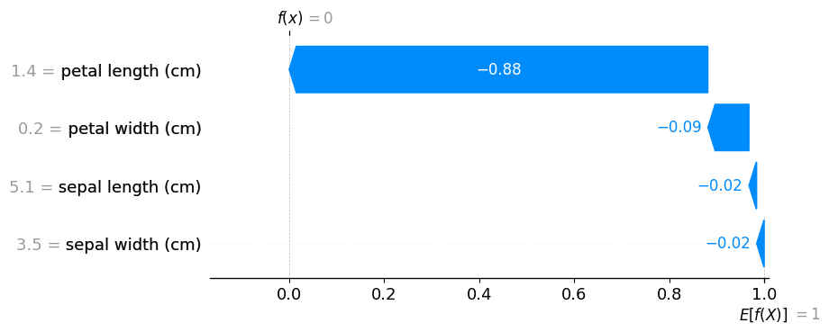
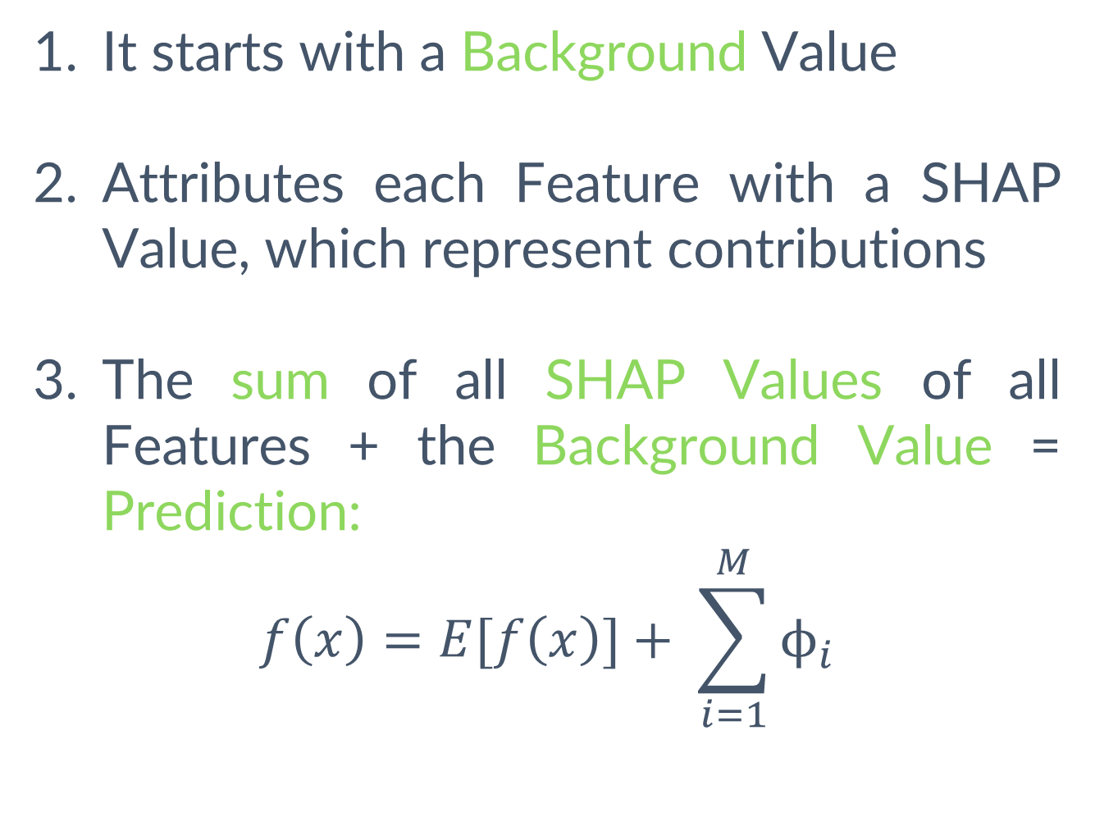
XAI Method: SHAP
SHapely Additive exPlanations
Example on the Iris Dataset:
Explains predictions by quantifying the contribution of each feature
Waterfall Plot:
How did we move from E[f(x)] to f(x)?
It starts with a Background Value
Attributes each Feature with a SHAP Value, which represent contributions
The sum of all SHAP Values of all Features + the Background Value = Prediction:
$$f\left(x\right)=E[f\left(x\right)]+ \sum_{i=1}^{M}{ϕ_{i}}$$
Final Prediction (0 = Setosa)
SHAP Values
(Contribution)
Background Value
(1 = Versicolor)

Slide 6
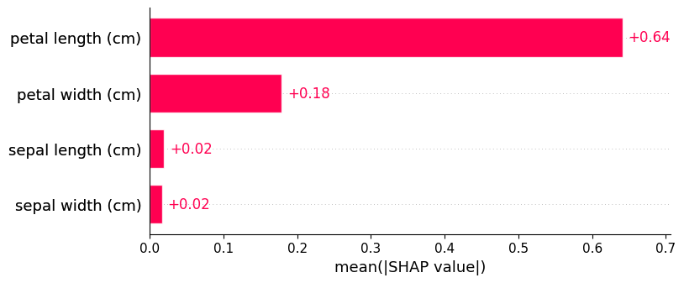
XAI Method: SHAP
SHapely Additive exPlanations
Example on the Iris Dataset:
Explains predictions by quantifying the contribution of each feature
Bar Plot:
Global Feature Importance
It starts with a Background Value
Attributes each Feature with a SHAP Value, which represent contributions
The sum of all SHAP Values of all Features + the Background Value = Prediction:
$$f\left(x\right)=E[f\left(x\right)]+ \sum_{i=1}^{M}{ϕ_{i}}$$

Slide 7
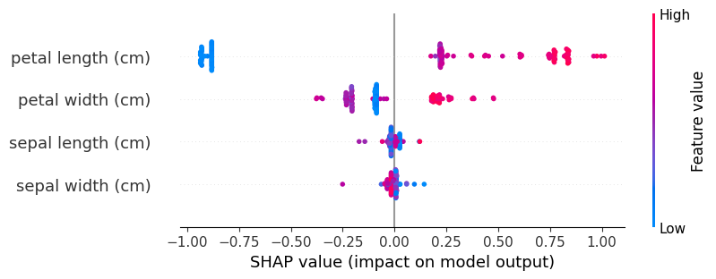
XAI Method: SHAP
SHapely Additive exPlanations
Example on the Iris Dataset:
Explains predictions by quantifying the contribution of each feature
Summary Plot:
Predictions Distribution
It starts with a Background Value
Attributes each Feature with a SHAP Value, which represent contributions
The sum of all SHAP Values of all Features + the Background Value = Prediction:
$$f\left(x\right)=E[f\left(x\right)]+ \sum_{i=1}^{M}{ϕ_{i}}$$

Slide 8
XAI Method: SHAP
SHapely Additive exPlanations
Limitation:
Not designed for Time Series or Sequential Data
Objective:
Apply SHAP to Time Series Data, Asses, and Improve
Explains predictions by quantifying the contribution of each feature

Slide 9
XAI Method: SHAP
SHapely Additive exPlanations
Limitation:
Not designed for Time Series or Sequential Data
Objective:
Apply SHAP to Time Series Data, Asses, and Improve
Explains predictions by quantifying the contribution of each feature

Slide 10
Remaining Useful Life Model
Dataset: C-MAPSS FD001
Model: LSTM
Multivariate Time Series Dataset for RUL Predictions of Aircraft Engines:
Long-Short Term Memory Model with Feed-Forward Neural Network:
24 Features at each Time Cycle:
21 Sensors
3 Operational Settings
Training Set has 100 Engines that run to Failure (Until RUL = 0)
Test Set has 100 Engines with the RUL given at the last Time Cycle
1 LSTM Layer, 3 Linear Layers, and 2 Activation Layers
Window Size of 20 Time Cycles
512.48 MSE and 16.94 MAE
Data Pre-processing includes:
Dropping 8 Features
Exponential Smoothing
Dropping first 10 Time Cycles
Min-Max Scaling

Slide 11
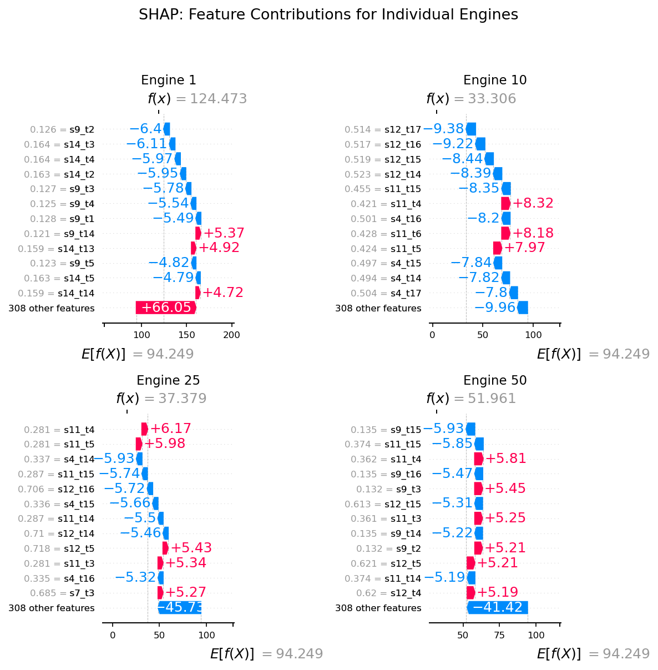
SHAP Results
Waterfall Plot for Engine 1
320 Features!

Slide 12
SHAP Results

Slide 13
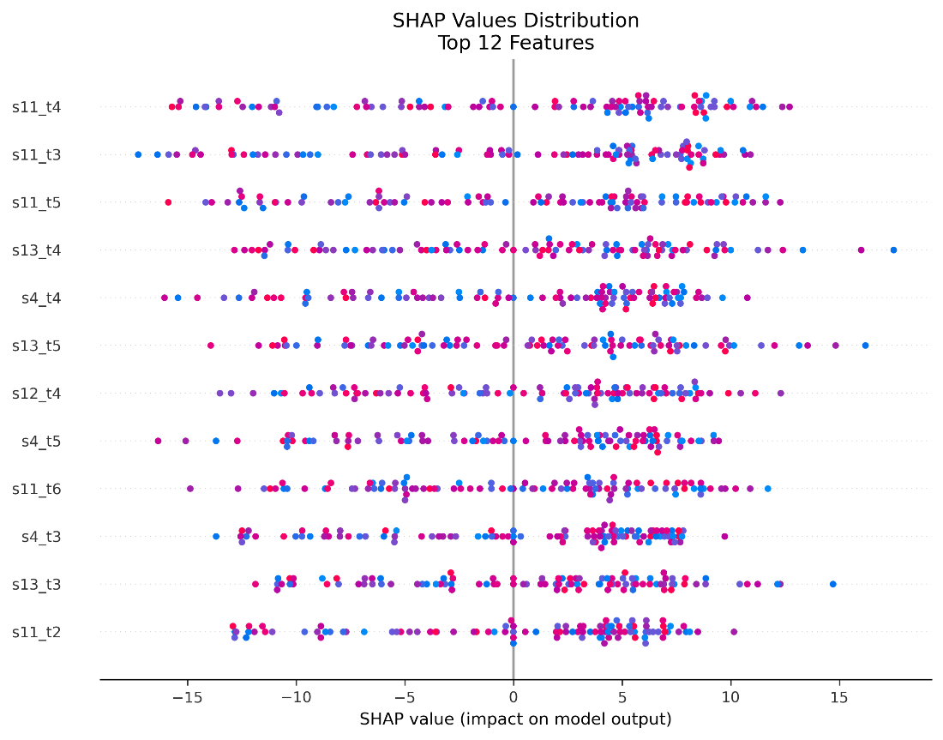
SHAP Results

Slide 14
SHAP Results
Summary:
No Temporal Interpretations
Treats sequences as independent features
Provides a sense of importance to sensors

Slide 15
Improvement: TimeSHAP
TimeSHAP
Extends SHAP to the sequential domain
Designed for Sequential Inputs, thus capturing temporal dynamics
Ability to also explain important events (Time Steps)

Slide 16
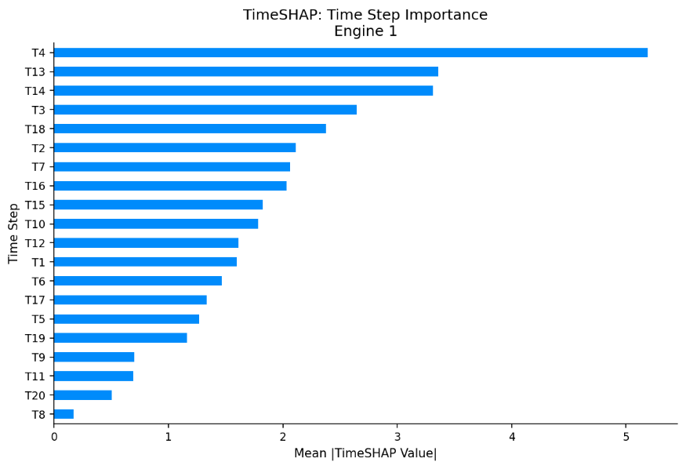
TimeSHAP Results
Events Importance for Engine 1

Slide 17
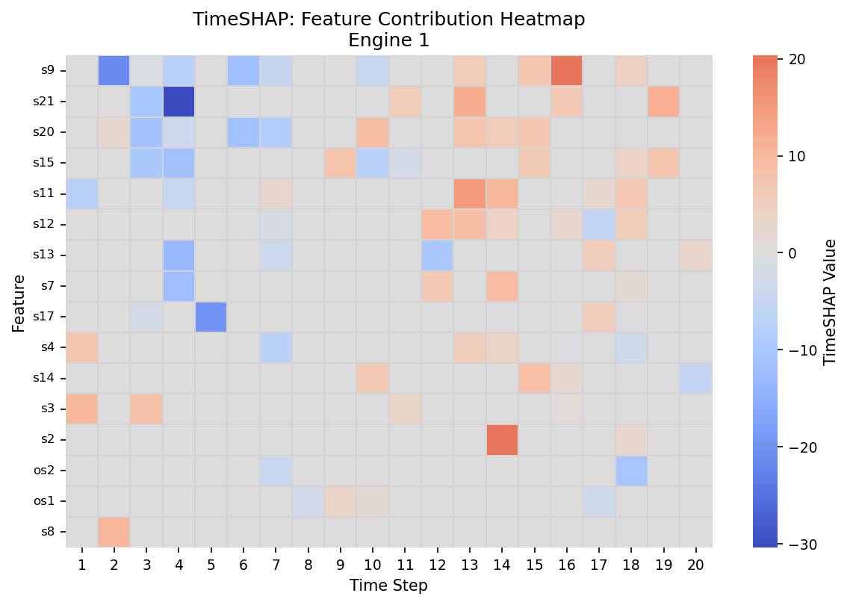
TimeSHAP Results
Events Importance for Engine 1
Feature Importance for Engine 1

Slide 18
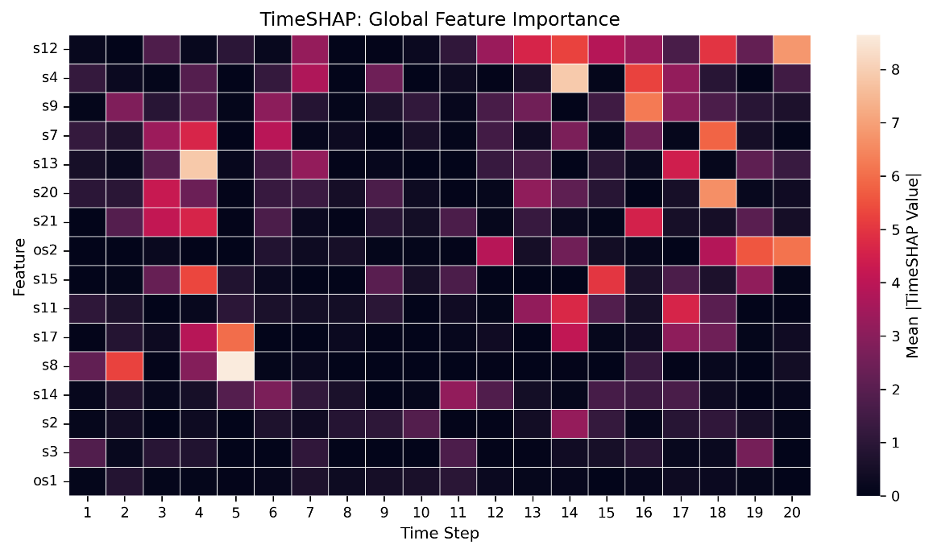
TimeSHAP Results
Overall Importance Summary

Slide 19
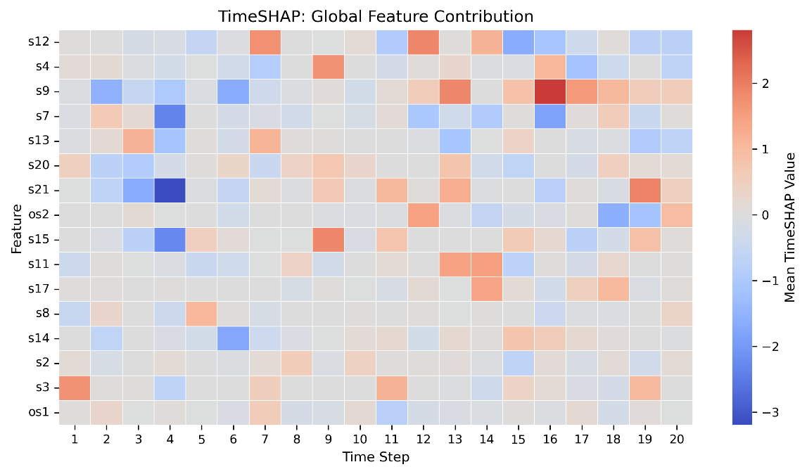
TimeSHAP Results
Overall Importance Summary
Overall Contributions Summary

Slide 20
TimeSHAP Results
Summary:
Richer interpretations
Provides Events Importance
Neglects features’ correlations
TimeSHAP
Extends SHAP to the sequential domain

Slide 21
Conclusion
XAI Methods
Offer great insights and allow for safer and reliable use of AI models
Future Work:
Develop XAI methods that account for feature correlations in a sequential domain
SHAP
Great at feature attributions to further understand predictions.
Lacks Sequential Data handling and interpretations
TimeSHAP
Captures temporal dynamics and offer time events explanations
Does not consider feature correlations

Slide 22
Conclusion
XAI Methods
Offer great insights and allow for safer and reliable use of AI models
Future Work:
Develop XAI methods that account for feature correlations in a sequential domain
SHAP
Great at feature attributions to further understand predictions.
Lacks Sequential Data handling and interpretations
TimeSHAP
Captures temporal dynamics and offer time events explanations
Does not consider feature correlations

Slide 23
THANK YOU

